Slide 1
How Vacancy Rates Affect Fair Market Rent
Mathew Scaria

Slide 2
Intro
Research Question: How do Vacancy Rates Affect Fair Market Rent?
Hypothesis: Low vacancy rate leads to higher rent and high vacancy rate leads to low rent
Dependent Variable: fmr_2bed (Fair Market Rent for a 2-bedroom unit)
Independent Variable: vacancy_rate (The percent of all housing units in a county that are vacant)
Controls: total_housing_units (Total number of housing units in a county, including apartments, houses, and all other unit types) median_income (Median household income in dollars) households_with_children (The number of families with children under 18)

Slide 3

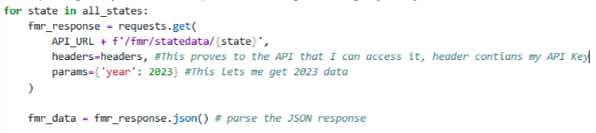
API & Data Collection Process
HUD Fair Market Rent API (huduser.gov)
HUD API Documentation Location: huduser.gov → Datasets → Fair Market Rents → API Documentation
The API documentation was straightforward to navigate, it clearly listed the available endpoints and what data each one returned
Before writing the full loop, I made a single API call for one state to explore the JSON response and understand the structure of the data, so I could identify which variables I needed.
To get the list of states, I used the fmr/listStates endpoint to retrieve all state codes rather than hardcoding them
I then looped through each state code, queried the fmr/statedata/{state} endpoint for 2023 data, and aggregated the results into a single dataframe containing county-level Fair Market Rent data
Other variables were obtained through the Census Bureau database through CSV files

Slide 4
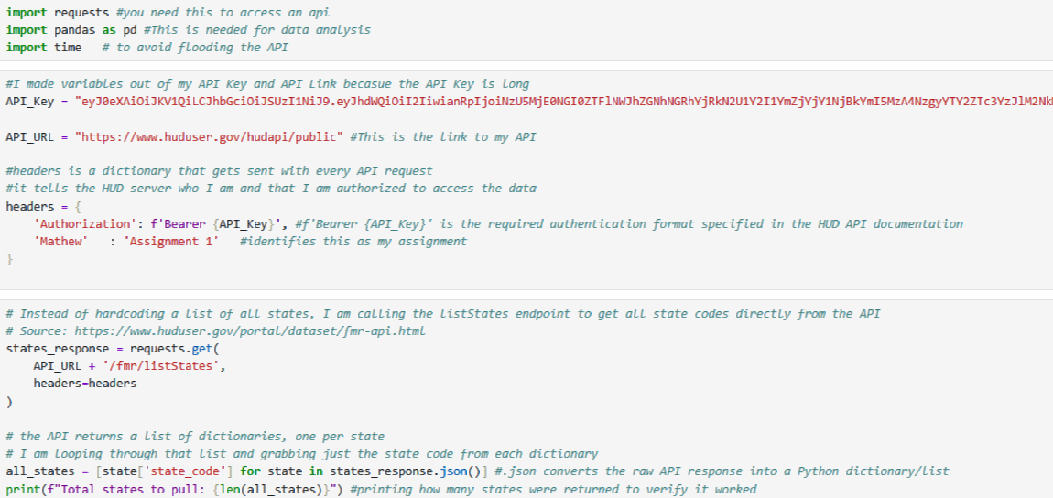

Slide 5
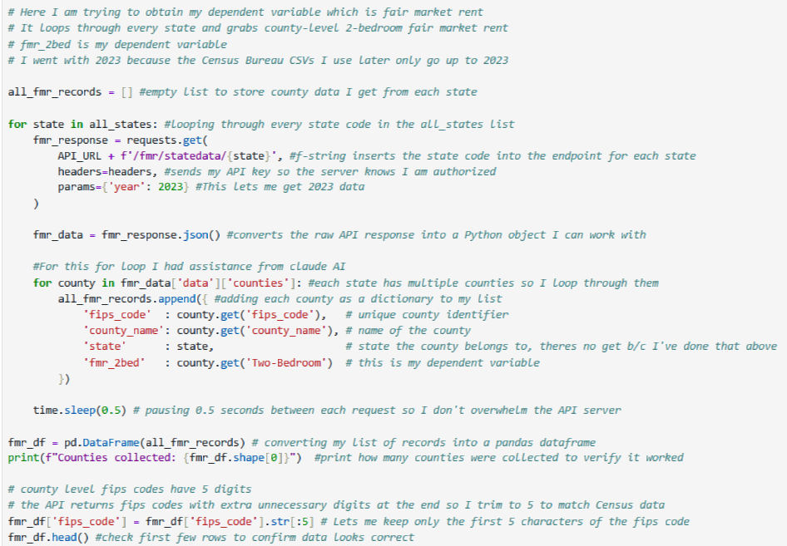

Slide 6
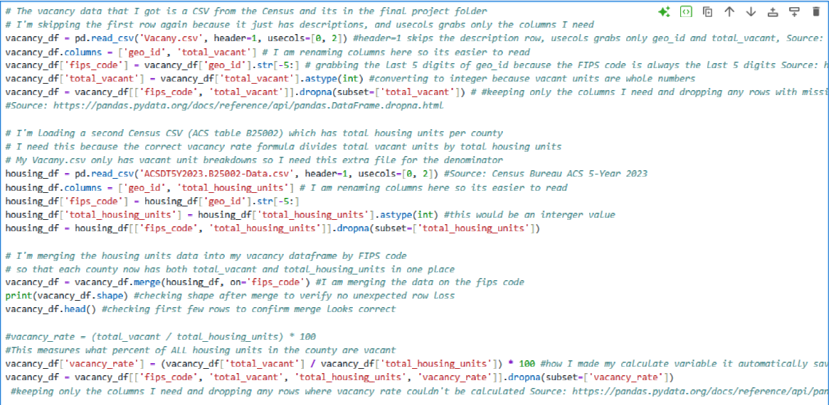

Slide 7
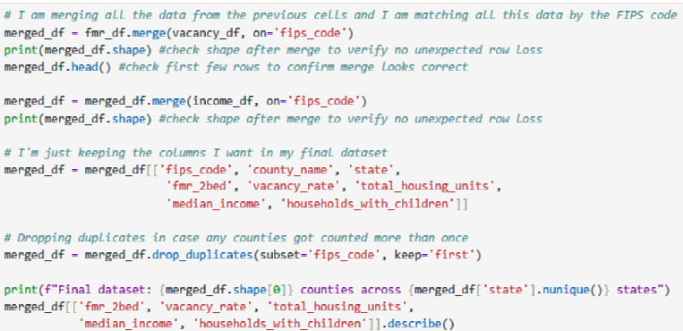

Slide 8
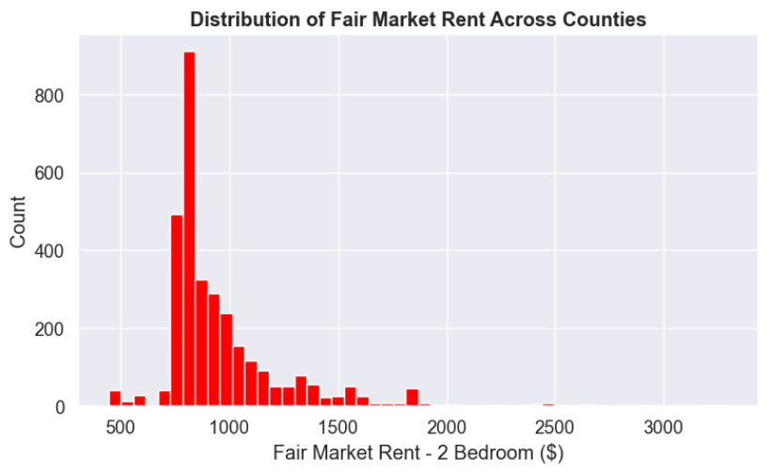
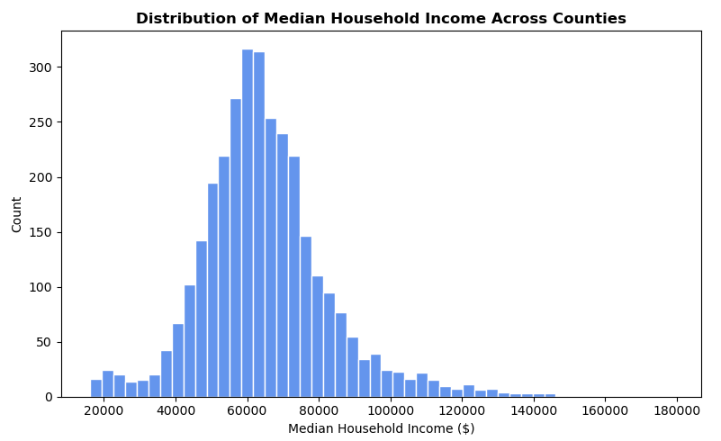
Graphs

Slide 9
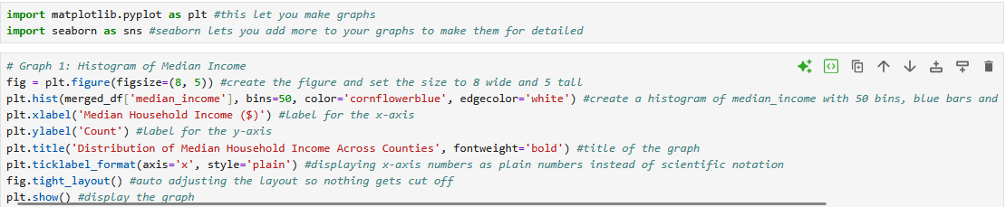
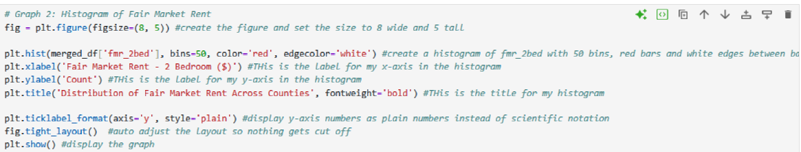
Graphs

Slide 10
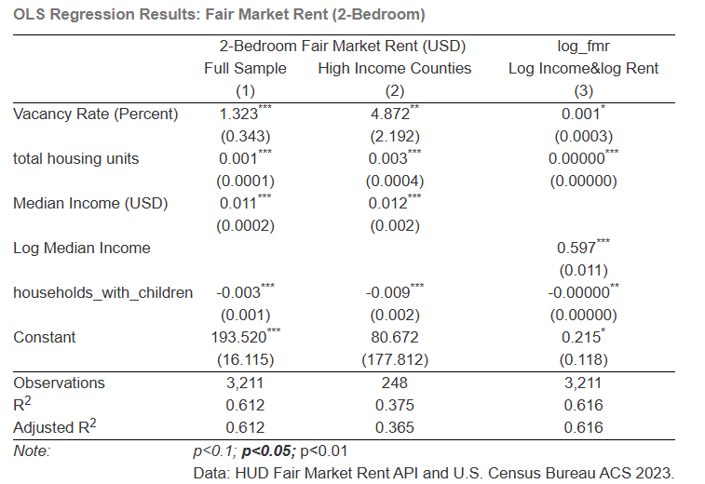
Results

